Slide 1
Positioning, Navigation, and Timing (PNT) and the
Second GPS
Civil Frequency
–
The Need for
Robust Radionavigation
Mitch Narins
Chief Systems Engineer - FAA Navigation Services
Space Weather Enterprise Forum
June 2011

Slide 2
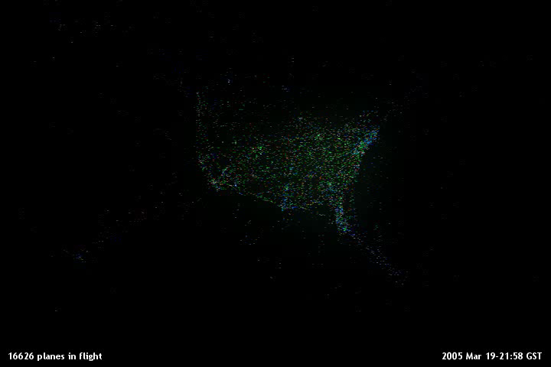

Slide 3


Slide 4
What is Robust Radionavigation?
ro·bust, adj, [rō-ˈbəst, ˈrō-(ˌ)bəst]
a: strong and healthy; having or exhibiting strength or vigorous health.
b: (of an object) strongly formed or sturdy in construction.
c: (of a process, system, organization, etc.) able to withstand or overcome adverse conditions.
. . . so let’s agree to define Robust Radionavigation as the provision of position, navigation, and timing (PNT) services that are strong, sturdy, and able to withstand or overcome adverse conditions.

Slide 5
What are Adverse Conditions?
Interference
  Intentional/Unintentional
  Predictable/Unpredictable
  Manmade/Environmental
  Crude/Sophisticated (Jamming/Spoofing)
  Widespread/Localized
Both suppliers and users of PNT services need to recognize the potential for real-world adverse conditions and plan and design accordingly

Slide 6
New GPS Civil Signal
As part of the GPS modernization effort there is a new third civil signal, L5
  Joins the legacy civil signal on L1 at 1575.42 MHz and the second civil signal on L2 (L2C) at 1227.60 MHz,
L5 is centered at 1176.45 MHz in the worldwide, protected, Aeronautical Radio-navigation Services band
L5 broadcasts at ~2x the power of the L1 and L2C signals
  Features wider bandwidth and longer spreading codes
  Will be particularly useful for enabling aircraft to make precision landings in high multipath environments
  Will reduce errors due to the ionosphere

Slide 7
Today’s Single Frequency Technology for
Detection of GPS Faults
Positioning & Fault Detection |  |  | Navigation | Surveillance
Ground-Based Augmentation System (GBAS) Detects 10 (28) m in 2 sec. vertical & horizontal (23 sats) | Wide Area Augment. System | Receiver Autonomous Integrity Monitoring | En Route | 5 nm
 | (WAAS) Detects 35 m in 6 seconds vertical & horizontal (22 sats) | (RAIM) Detects 200 m in 2 seconds (28 sats) | Terminal & LNAV | 3 nm
 |  |  | RNP | Dependent parallel approaches
 |  |  | LPV LPV-200 | Independent parallel approaches
 |  |  | Cat I & Cat II/III | Independent parallel approaches

Slide 8
Utility of Dual Frequencies &
Multiple Constellations
Positioning & Fault Detection |  | Navigation | Surveillance
Dual freq GBAS Detects 10 m in 2 sec. (23 sats) + Hardened against RFI |  | En Route | 5 nm
 | Dual Frequency SBAS Research & Development on Multi-constellation ARAIM | Terminal & LNAV | 3 nm
 |  | RNP | Dependent parallel approaches
 |  | LPV LPV-200 | Independent parallel approaches
 |  | Cat I & Cat II/III | Independent parallel approaches

Slide 9
Our Advanced RAIM (ARAIM) Choices
Original ARAIM + Integrity Support Message (ISM):
  Prove that multi-SV navigation message faults cannot cause HMI in the time since the last ISM.
Original ARAIM + ISM + Constellation Comparison:
  Prove that multi-SV failures are independent from one constellation to another.
Replace SBAS network GNSS navigations message with a level B navigation message
SBAS monitors one constellation & ARAIM accepts SVs from other constellations.

Slide 10
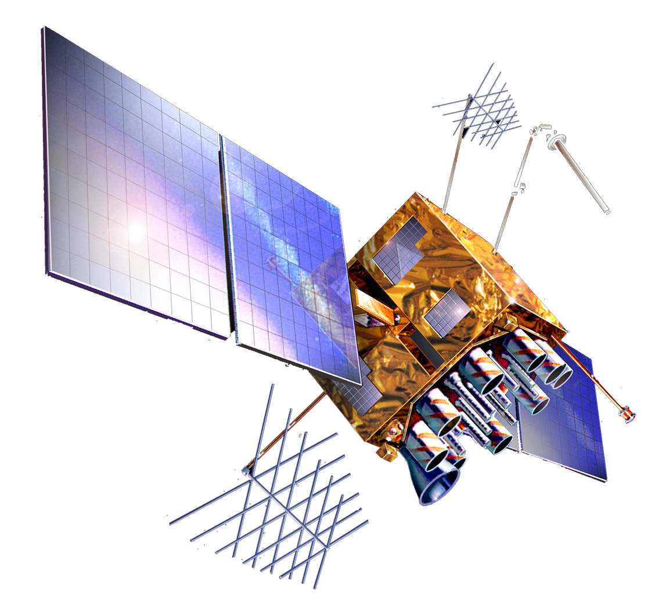

ARAIM Parameters
P_{sat}
GNSS-1
GNSS-2
P_{sat}
P_{sat}
P_{sat}
P_{sat}
P_{const} ← independent → P_{const}
P_{sat}
URA, b
URA, b

Slide 11
Summary: Advanced RAIM (ARAIM) Trade Space
 | GEO or ISM? | # SVs (guess) | Difficulty of proof | Comments
Original ARAIM + Integrity Support Message (ISM) | ISM | 27 + 27 | High ! Earth Orientation Parameters (EOP) + Level D | Prove that multi-SV navigation message faults cannot cause HMI in time between ISMs
Original ARAIM + ISM + constellation cross comparison | ISM | 30 + ? | Medium | Prove that multi-SV failures are independent from one constellation to another
SBAS network replaces GNSS nav. message.with level B nav message. ARAIM for fast faults | ISM | 27 + 27 | Low | Must build a global comm. network & level B processing station
SBAS monitors one constellation & ARAIM accepts SVs from other constellations | GEO | 22 + anything | Low | Different SBAS may monitor different constellations

Slide 12
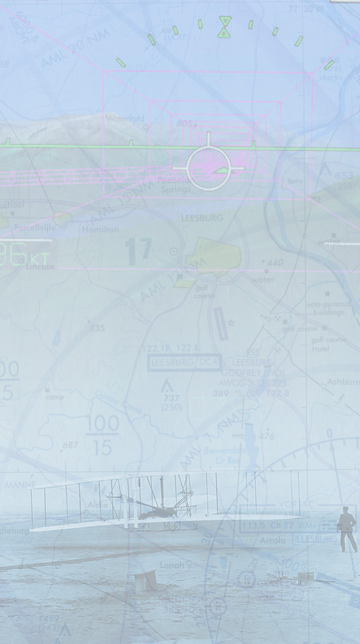
Satellite-Based
Augmentation Systems
(SBAS)

Slide 13
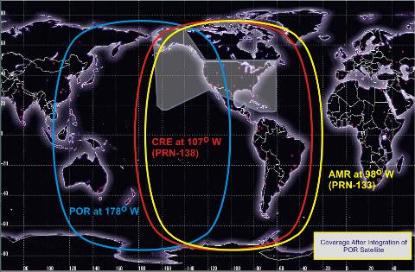

Slide 14
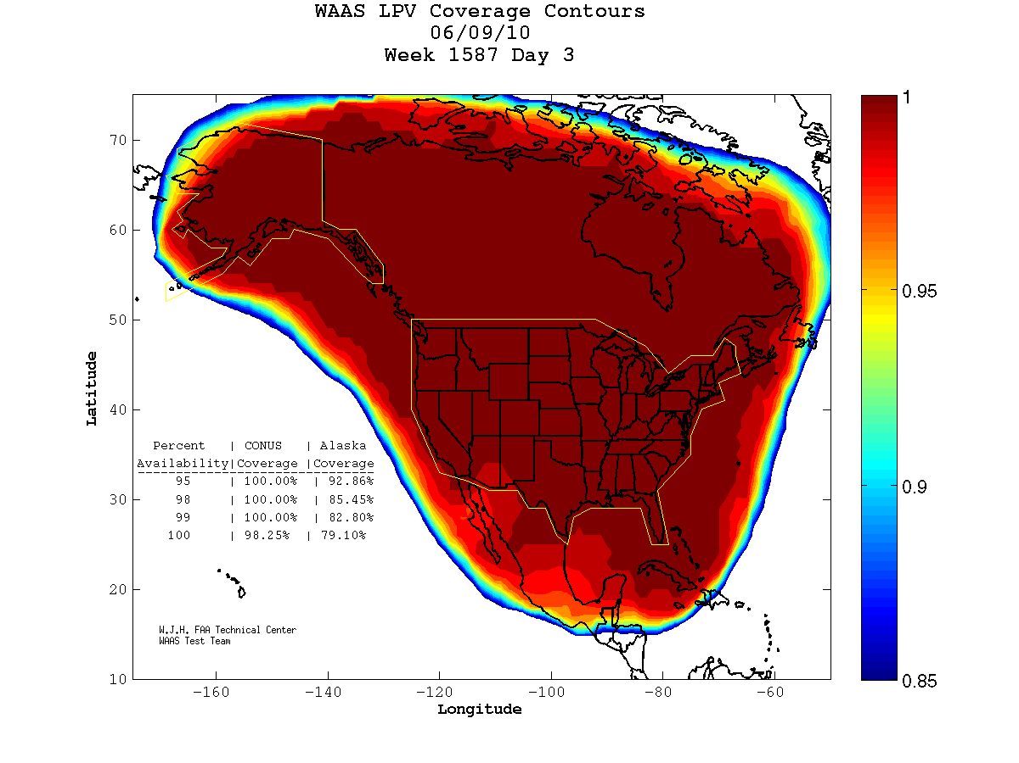
Typical WAAS Performance Availability
Notes:
WAAS Lifecycle is broken into four phases
Phase I-Initial Operating Capability provided LNAV/VNAV
Phase II- consisted of architecture and performance upgrades: additional WRSs in Canada, Mexico and Alaska were procured, upgraded communication, O&M enhancements, GEO replacement, WMS, and software upgrades
Phase III- Replacement of Legacy WRSs, router upgrades, software enhancements, L5 transition activities: Specifications, ICDs, MOPs development, WRS receiver development, Develop L5 Transition Plan
Phase IV- Dual Frequency Operations- Dual Frequency Operations will allow WAAS to broadcast on two civil frequencies L1, L5. Activities that will occur new safety computer, new processor
L1-
L2-
L5-
14

Slide 15
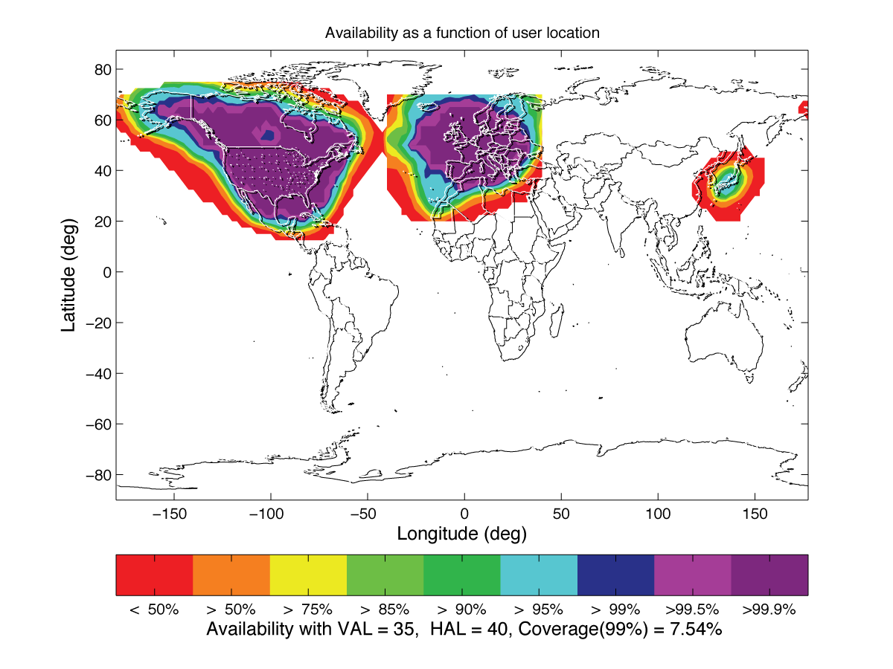
Current Single Frequency World Coverage
WAAS
EGNOS
MSAS

Slide 16
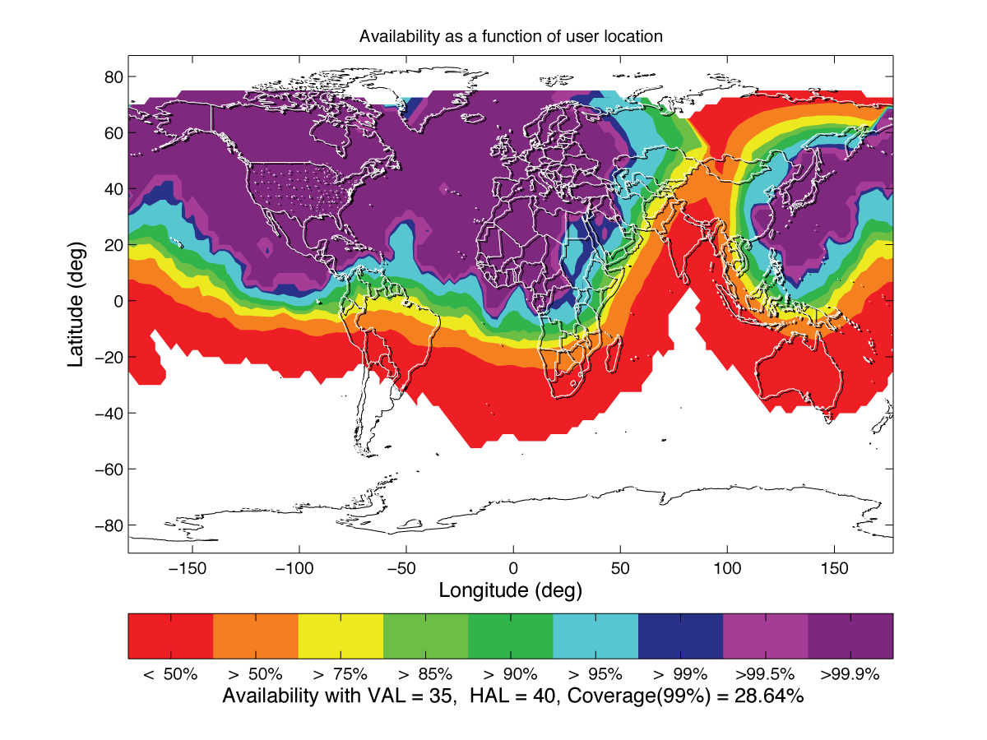
Dual Frequency Coverage
WAAS
EGNOS
MSAS

Slide 17
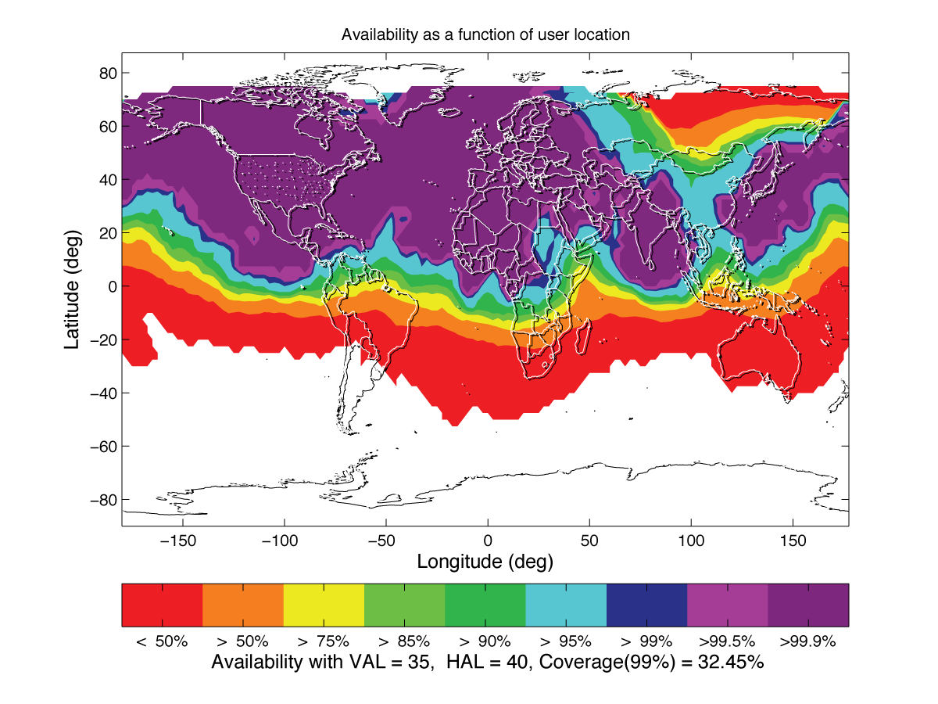
Dual Frequency Coverage
WAAS
EGNOS
MSAS
GAGAN

Slide 18
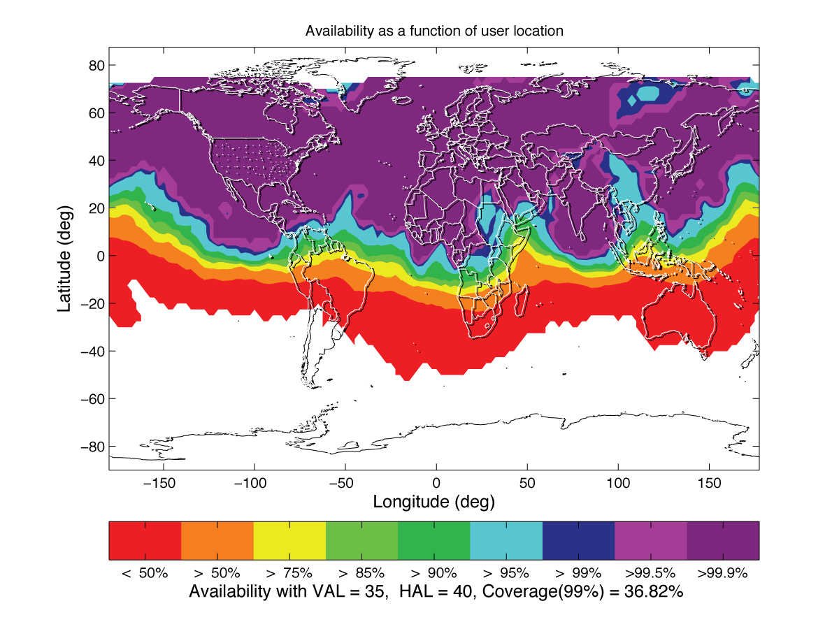
Dual Frequency Coverage
SDCM
WAAS
EGNOS
MSAS
GAGAN

Slide 19
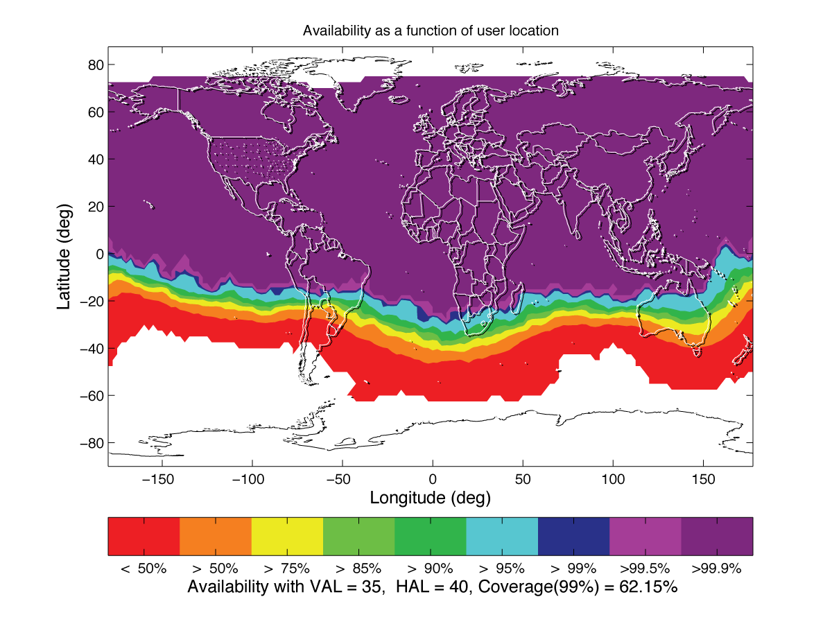
Dual Frequency +
Second Constellation (Galileo)

Slide 20
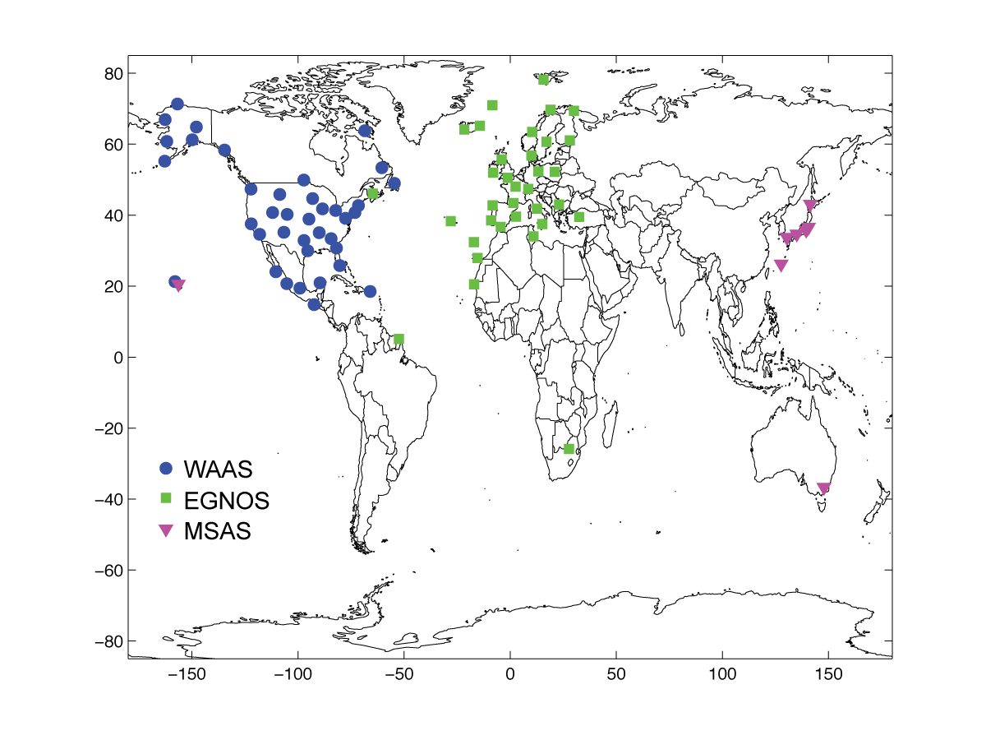
Current Reference Networks

Slide 21
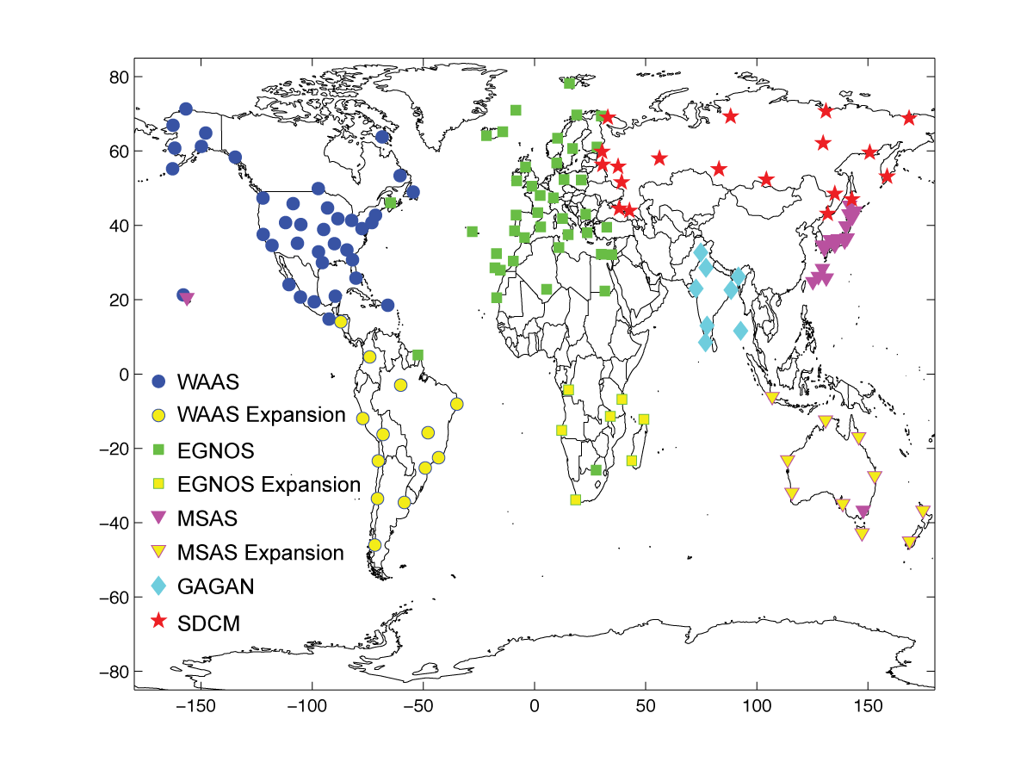
Expanded Networks
WAAS
EGNOS
MSAS
GAGAN
SDCM

Slide 22
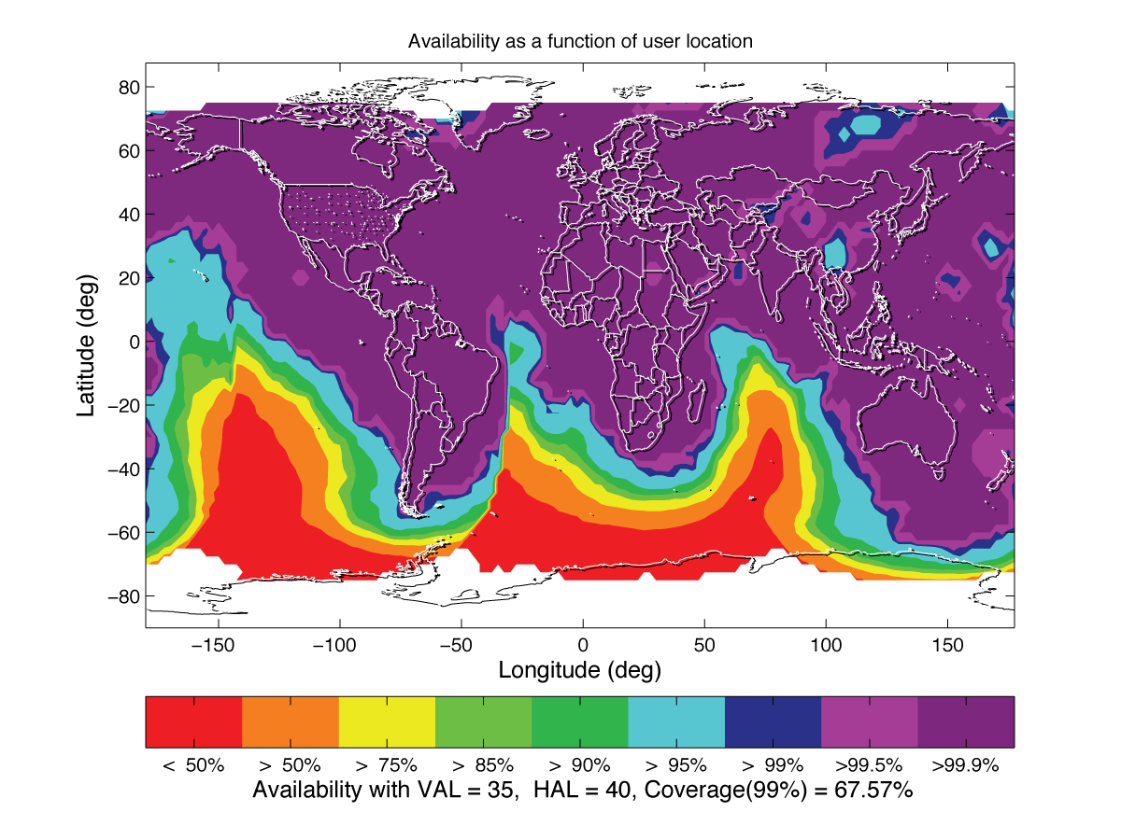
Dual Frequency + Expanded Networks

Slide 23
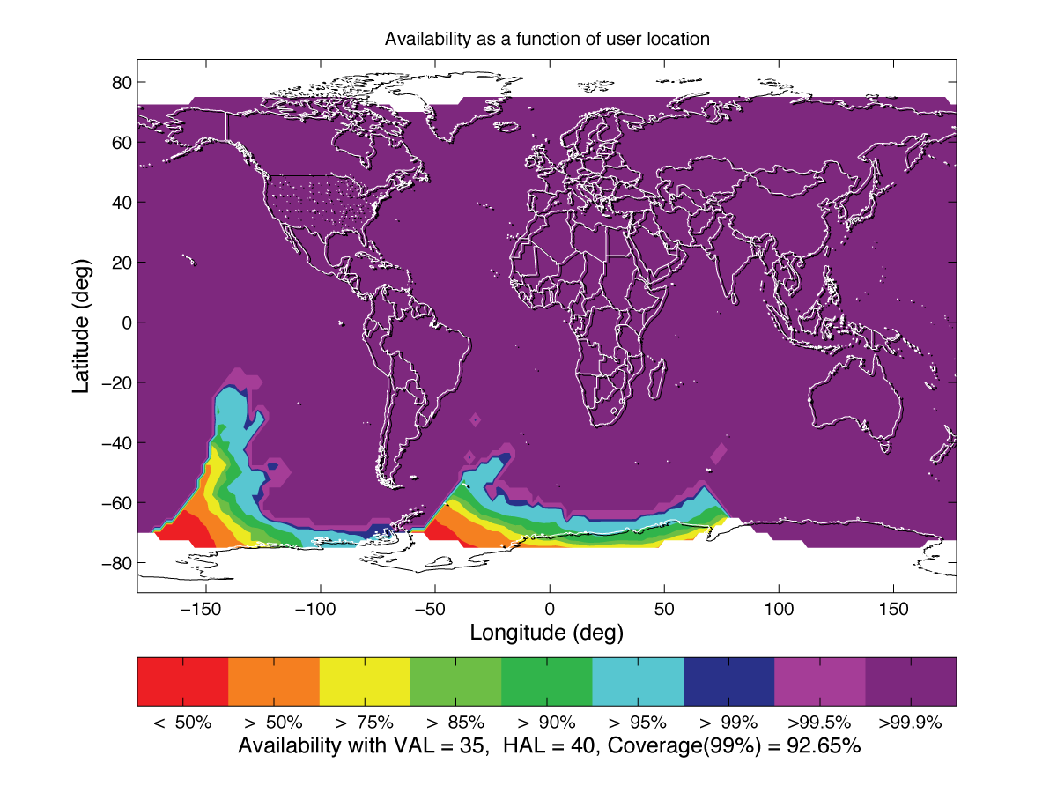
Dual Frequency + Dual GNSS + Expanded Networks

Slide 24
Dual Frequency ARAIM With 27 GPS + 27 Galileo
Allow other
constellations..
Get rid of the
GEOs.
Robust to weak
constellations?
URA = 1m
P_{sat}=10⁻³
P_{const} = 10⁻⁶

Slide 25
Summary: ARAIM Trade Space
 | GEO or ISM? | # SVs (guess) | Difficulty of proof | Comments
Original ARAIM + ISM | ISM | 27 + 27 | High ! EOP + Level D | Prove that multi-SV navigation message faults cannot cause HMI in time between ISMs
Original ARAIM + ISM + constellation cross comparison | ISM | 30 + ? | Medium | Prove that multi-SV failures are independent from one constellation to another
SBAS network replaces GNSS nav. message.with level B nav message. ARAIM for fast faults | ISM | 27 + 27 | Low | Must build a global comm. network & level B processing station
SBAS monitors one constellation & ARAIM accepts SVs from other constellations | GEO | 22 + anything | Low | Different SBAS may monitor different constellations

Slide 26
Summary
Single frequency coverage is good within the countries fielding SBAS
Dual frequency extends coverage outside reference networks & allows LPV* operation in equatorial areas
Expanding networks into southern hemisphere could allow global coverage of land masses
Additional constellations allow even greater coverage with fewer stations
*LPV=Localizer Performance w/Vertical

Slide 27

Questions mitchell.narins@faa.gov

